Slide 1

Title: Offline Music Search and retrieval Studio
Student Name: VSB Sujit
Student ID: 2520090085
Cluster:2
Section: 6
Under the Guidance
of
Supervisor Name: Dr Y Ashok
Assistant Professor
Department of CS

Slide 2
OUTLINE
Abstract
Existing System
Proposed System
System Architecture
Project Modules
Objectives
Co’s Attainments - FWD
Co1
Co2 …….. 5. Co5
Co’s Attainments - DSA
Co1
Co2 …….. 5. Co5
Screen Shots for FWD & DSA
Conclusion
Geo-Tagged Photos

Slide 3
Abstract
Offline Music Search and Retrieval Studio (OMSR) designed to manage and retrieve music efficiently
• Provides a platform to organize and manage offline music playlists • Built using HTML, CSS and JavaScript for the user interface • Allows users to add and manage songs in playlists • Implements search and sorting operations for songs • Uses Java console implementation to demonstrate DSA concepts • Demonstrates application of linked lists, stacks, queues, hashing and heaps

Slide 4
Existing System
• Traditional music players rely heavily on internet connectivity
• Limited demonstration of algorithmic structures in music systems
• Searching songs in large collections is inefficient
• Playlist organization is often unstructured
• Lack of educational demonstration of data structures

Slide 5
Proposed System
Offline music management system
Allows users to manage songs in playlists
Provides search functionality for quick song retrieval
Implements sorting algorithms for organizing songs
Demonstrates data structures through console operations
Helps understand real-world applications of DSA concepts

Slide 6
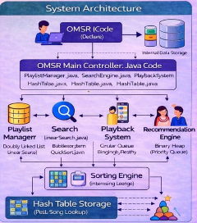
System Architecture

Slide 7
Project Modules
Module 1 – User Interface Module • HTML interface for music player and playlist display
Module 2 – Playlist Management Module • Add, remove and display songs in playlist
Module 3 – Search Module • Implements search functionality for songs
Module 4 – Sorting Module • Organizes songs using different sorting algorithms
Module 5 – Playback Control Module • Handles next, previous and play operations
Module 6 – Data Structure Module • Implements stacks, queues, heaps and linked lists

Slide 8
Objectives
• Develop an offline music management system
• Demonstrate practical implementation of DSA concepts
• Implement efficient search and sorting algorithms
• Organize playlists using appropriate data structures
• Improve efficiency of music retrieval
• Demonstrate real-world use of algorithms

Slide 9
Co’s Attainments - DSA
CO1
CO2
Implementation of Linear Search to locate songs by title, artist, or genre. Implementation of Binary Search for efficient song lookup in sorted arrays. Analysis of search performance by counting comparisons during search operations. Understanding algorithm efficiency and time complexity in searching tasks.
Implementation of Bubble Sort to sort songs by title. Implementation of Insertion Sort to organize songs by artist name. Implementation of Merge Sort to rank songs based on rating. Implementation of Quick Sort to order songs based on play count. Measurement of sorting performance using execution time calculations

Slide 10
Co’s Attainments - DSA
CO4
Implementation of Circular Queue to manage upcoming songs. Implementation of Binary Heap (Priority Queue) to generate song recommendations. Implementation of Hash Table with separate chaining for fast song lookup. Efficient key-based search of songs using hashing techniques.
CO3
Implementation of Doubly Linked List to manage playlists. Efficient insertion, deletion, and traversal of songs in playlists. Navigation between songs using previous and next node pointers. Implementation of Stack data structure to maintain playback history. Application of stack algorithms such as Infix to Postfix conversion, Postfix evaluation, and bracket balancing.

Slide 11
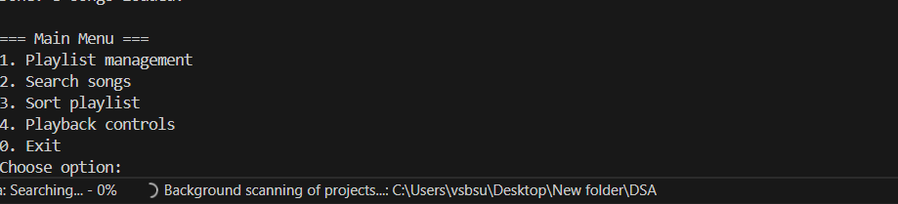
Screenshots for FWD & DSA

Slide 12
Conclusion
Demonstrates practical implementation of Data Structures and Algorithms using a Java console application.
• Uses Doubly Linked List, Stack, Circular Queue, Hash Table, and Binary Heap for efficient music management.
Implements searching and sorting algorithms to organize and retrieve songs effectively.
Shows how DSA concepts can be applied to build an efficient offline music search and playlist management system.

Slide 13
Future Enhancements
Develop a Graphical User Interface (GUI) for better user interaction.
Integrate a database to store songs and playlists permanently
Add audio playback support for playing songs directly within the application.
Extend the system to a web or mobile application for wider accessibility.
Implement AI-based recommendation algorithms for smarter song suggestions.

Slide 14
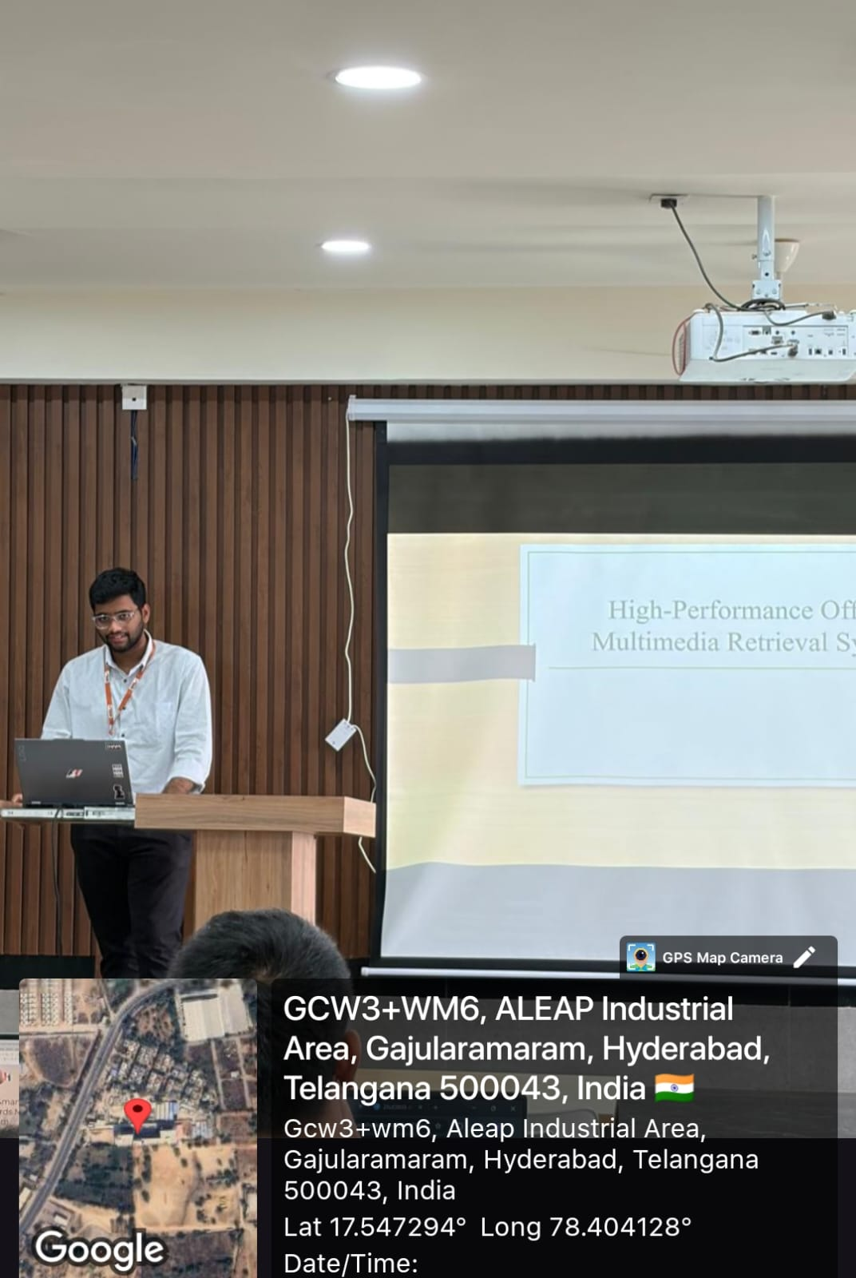
Geo- Tag Photos

Slide 15
THANK YOU

